Slide 1



ROUGIR COSMETICS INTERNATIONAL
NATURAL COSMETICS
FIRAS BIDAWI, REEM TARAKJI, RODRIGUE N'SENGA,
SAHIL NADIYADRA, SHALINI JAMES PAULRAJ, SHARAYU MIRAJKAR
-TEAM 6-
Notes:
Title slide

Slide 2

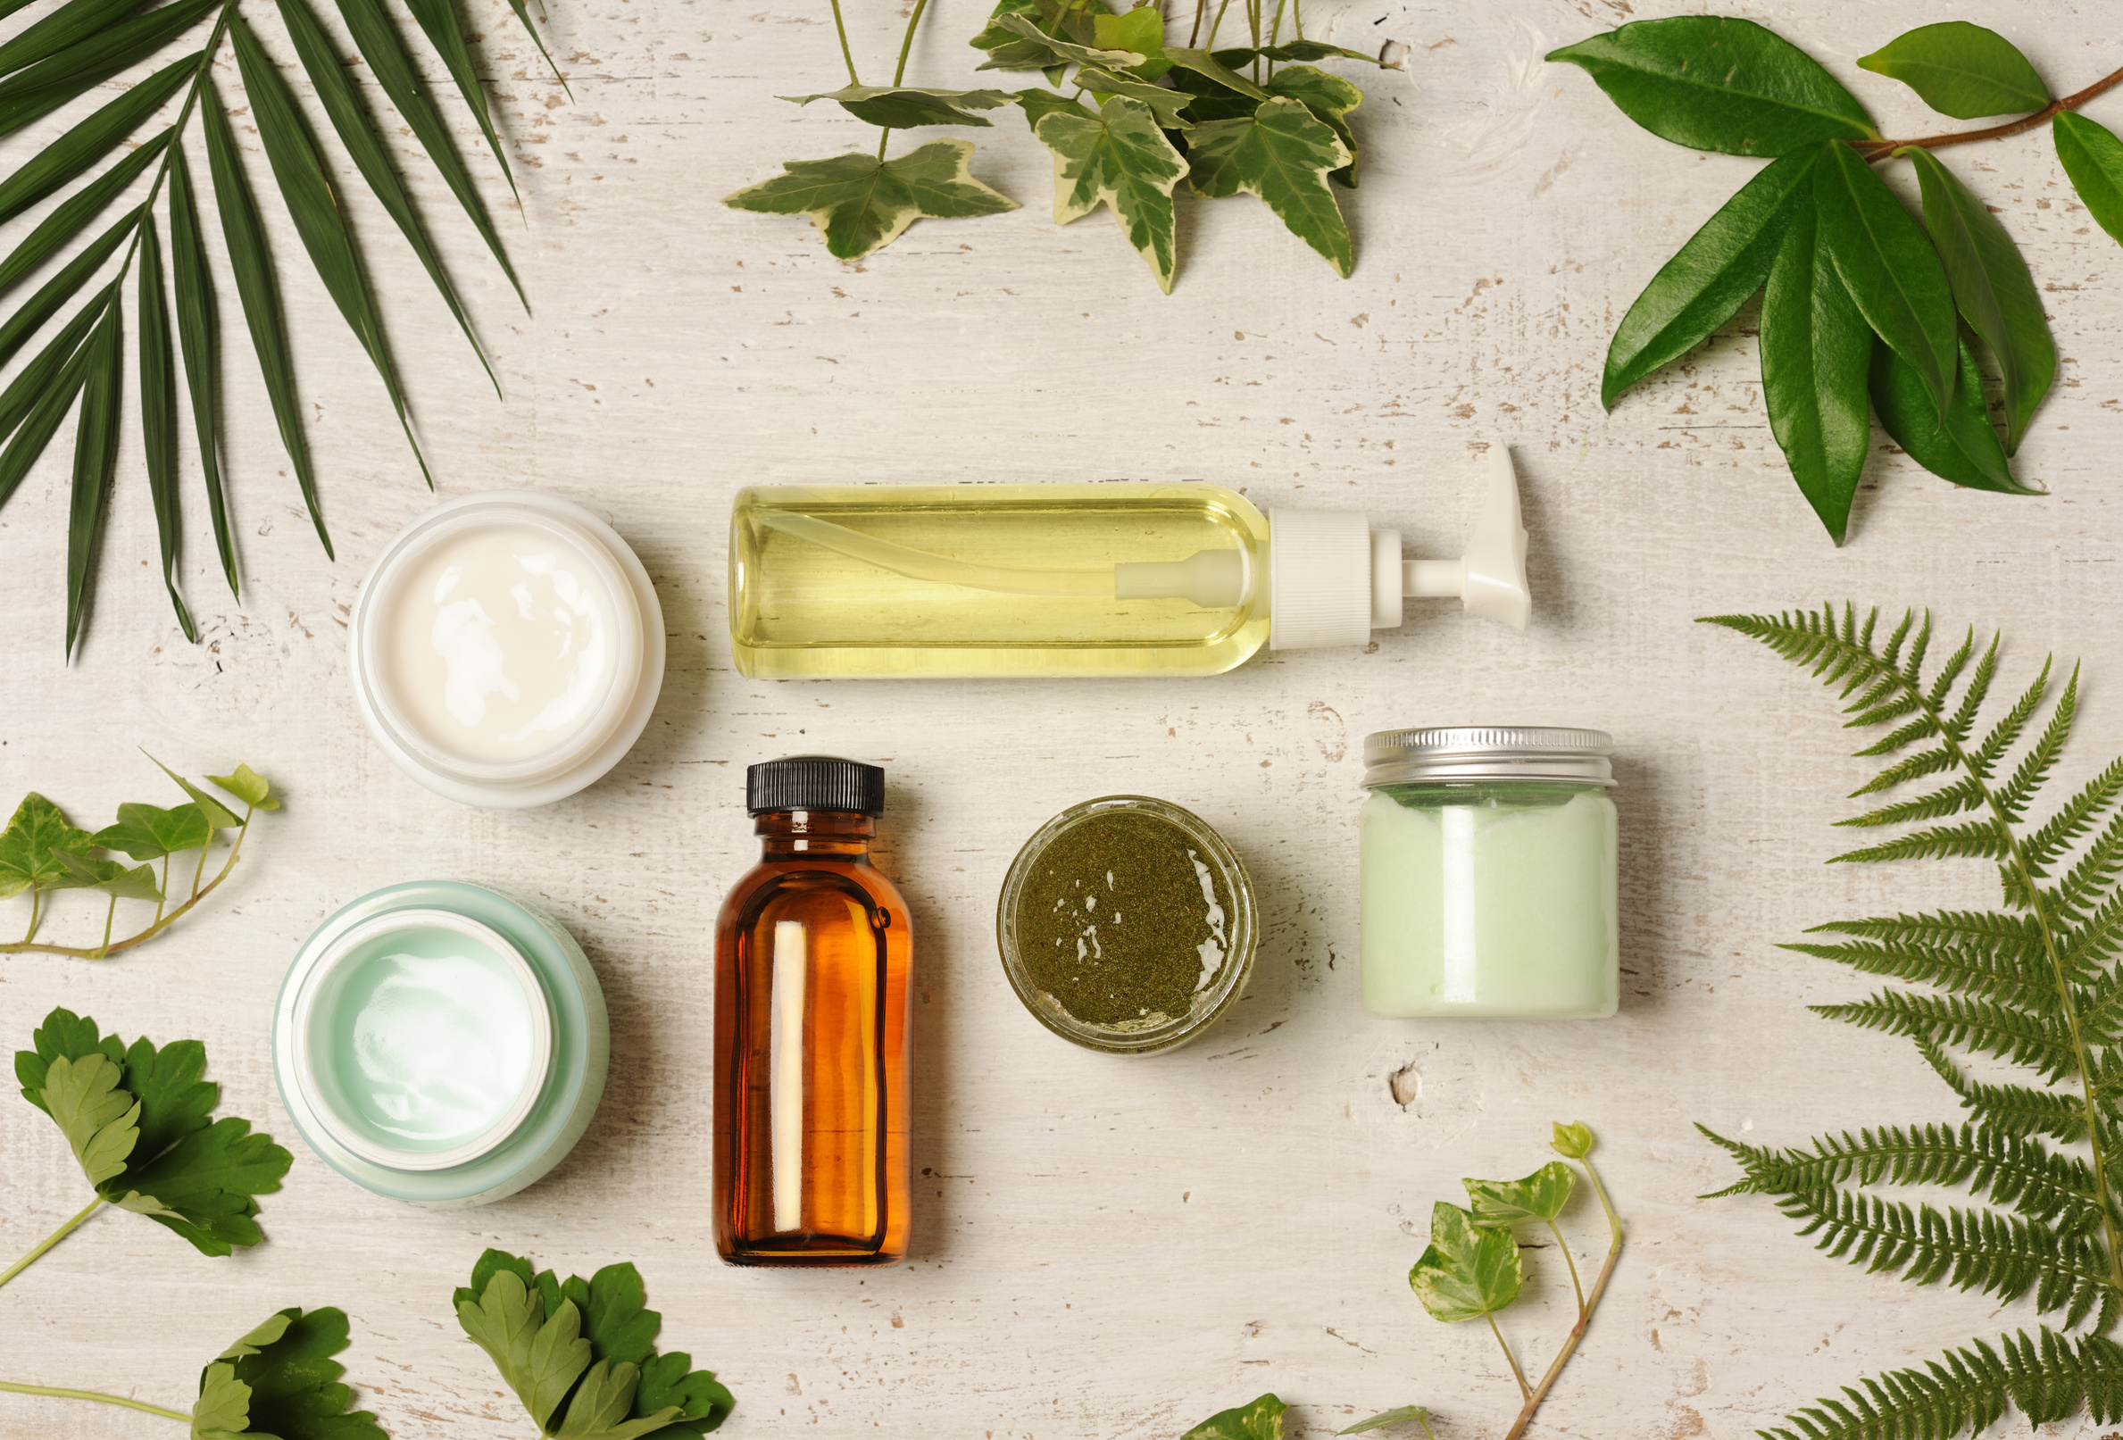
INTRODUCTION
Rougir Cosmetics International (RCI California, 2010), is one of the fast-growing businesses in skin care products. RCI adopted a subscription-based e-commerce model in 2016 aiming to shape consumer loyalty and guarantee a steadily growing demand for its products that cater to a variety of customer tiers with different needs.
The cosmetics industry has skyrocketed in the past decade reaching over $670 billion in revenue in 2020, where the skincare line alone is responsible for 36% of the overall market.
Consumer interest has shifted towards environmentally friendly products made with natural components that are increasing in price and are considered a main factor in the industry economy, and are price determinations, along with heavy investment in R&D and technology.
Notes:
Introduction about the company

Slide 3

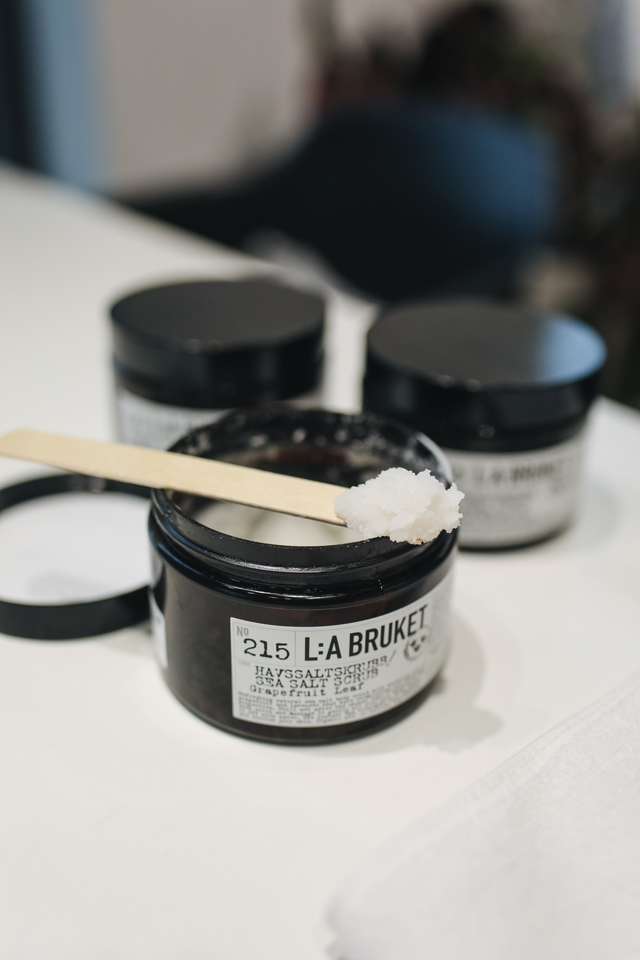
THE CHALLENGE
During the board meeting of RCI in June 2016, CEO Shelly Anderson disclosed that the company’s current production capabilities were inadequate to satisfy the expected growing demand for the following quarter.

Slide 4

Problem overview
Constraints
While outsourcing a portion of production to an external vendor was proposed as a temporary solution, concerns were raised regarding the potential risk of exposing proprietary product formulas, especially given the vendor’s possible involvement in manufacturing hand creams.
The goal is to formulate a production strategy that can fulfill demand while also minimizing costs and preserving product integrity of the hand cream.
Demand to meet:
12,000 cartons of face cream
8,000 cases of body cream
18,000 cases of hand cream
Material limitation for production:
200,000 pounds of purified water
50,000 pounds of oil
7,500 pounds of scents and colors
15,000 pounds of emulsifiers
Labor hours available:
Stage 1 shift 1 (15,000 labor hours)
Stage 2 shift 1 (10,000 labor hours)
Stage 1 shift 2 (13,500 labor hours)
Stage 2 shift 2 (9,000 labor hours)
Notes:
Problem overview

Slide 5
APPROACH
Define constraints (labor hours, material limits, demand fulfillment).
Calculate the production cost per carton for all shifts and outsourcing. (Appendix 8)
Solve for minimum cost
OPTIMIZATION MODEL
DESCION VARIABLES (NUMBER OF CARTONS PRODUCED)
OBJECTIVE FUNCTION
Min Cost=(XFC1​⋅CFC1​)+(XBC1​⋅CBC1​)+(XHC1​⋅CHC1​)+(XFC2​⋅CFC2​)+(XBC2​⋅CBC2​)+(XHC2​⋅CHC2​)+(OFC​⋅COFC​)+(OBC​⋅COBC​)
Face Cream Production: Shift 1
Face Cream Production: Shift 2
Hand Cream Production: Shift 1
Hand Cream Production: Shift 2
Body Cream Production: Shift 1
Body Cream Production: Shift 2
Outsourced Face Cream
Outsourced Body Cream
Where:
X = Number of cartons produced
O = Number of cartons outsourced
C = Cost per carton
FC, BC, HC = Face Cream, Body Cream, Hand Cream
1, 2 = Shift 1, Shift 2

Slide 6
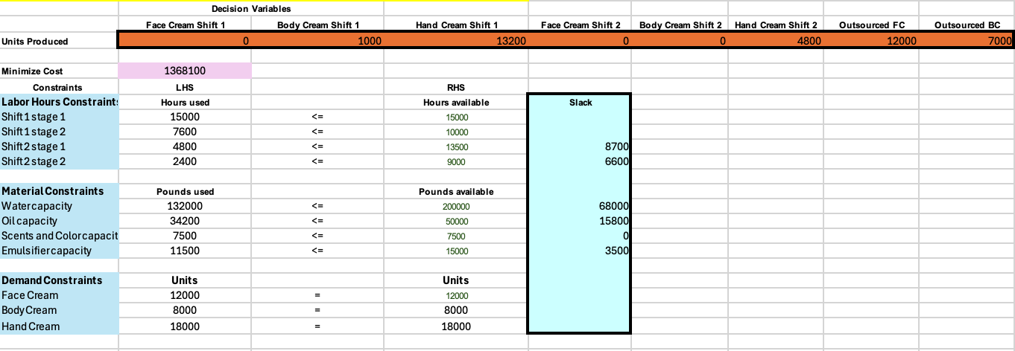
MODEL RESULTS
The minimum cost for the next production cycle is $1,368,100.
ISSUES TO ADDRESS:
87.5% of Body cream production and 100% of Face cream production are outsourced.
24% of Shift 1 stage 2 available hours are unused because stage 1 capacity is saturated, leading to an overreliance on the 10% more expensive Shift 2, increasing overall labor costs.
Scents and color capacity is saturated, leading to increased volume of outsourced production.
Notes:
·From a reputational and financial standpoint for the company, having this level of reliance on a third-party supplier is not preferable at all, especially for two best selling products. With the growing demand for Rougir products, there needs to be efforts and plans to restructure the production line model for the company to be able to meet customer demands with little to no reliance on third party suppliers on the upcoming quarters. ·Additionally, as Rougir has shown continuous growth and robust demand due to its subscription-based model, a possible renegotiation of the labor hour per stage capacity can be done to reduce costs. ·All the other material, have considerable slack, meaning running out of scents of color led to a premature transition into outsourcing products, instead of maximizing the available hours for shift 2.

Slide 7
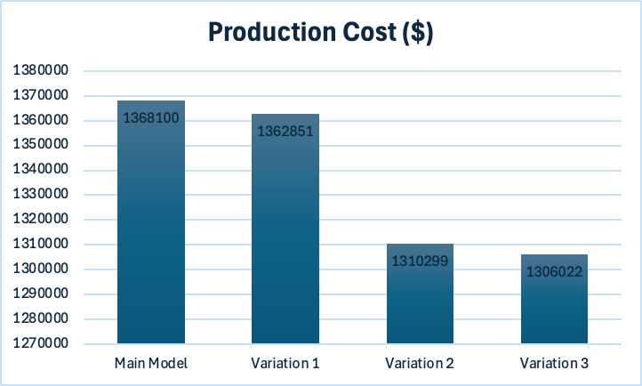
MODEL VARIATIONS
Variation 1: Increase stage 1 shift 1 labor hour capacity from 15000 to 19000 hours.
Variation 2: Increase the scents and color capacity from 7500 to 9500 pounds.
Variation 3: Variation 1 + 3

Slide 8





RECOMMENDATIONS
Cost Optimization
Subcontractor Efficiency
Risk Mitigation
Invest in increasing internal capacity for Face and Body Cream to reduce outsourcing.
Invest in securing additional material inventory to satisfy through internal production continuously growing demand for Rougir products.
Short term, prioritize negotiating Stage 1 Shift 1 labor hours capacity increase (as seen in Variation 1) to reduce outsourcing costs.
Increase overall labor capacity to reduce dependancy on outsourcing long term.
Supply Chain Hedging: Develop strategies to mitigate raw material cost volatility due to crude oil price fluctuations.
Sustainability and Market Strategy
Performance Metrics
KPIs to Track: Cost Savings per Unit, Production Time Reduction, Customer Satisfaction.
Sustainable Practices: Intensify efforts if sustainable sourcing can reduce environmental impact by 20% and increase consumer purchase intent by 40%.
Focus on Asia-Pacific: Customize products for the Asia-Pacific market to potentially increase market share by 15%.

Slide 9







LINKEDIN
Firas Bidawi
www.linkedin.com/in/firasbidawi
Reem Tarakji
www.linkedin.com/in/reem-tarakji/
Rodrigue N'senga
www.linkedin.com/in/rodriguensenga
Sahil Nadiyadra
www.linkedin.com/in/sahilnadiyadra/
Shalini James Paulraj
www.linkedin.com/in/shalinijamespaulraj/
Sharayu Mirajkar
www.linkedin.com/in/sharayu-mirajkar

Slide 10
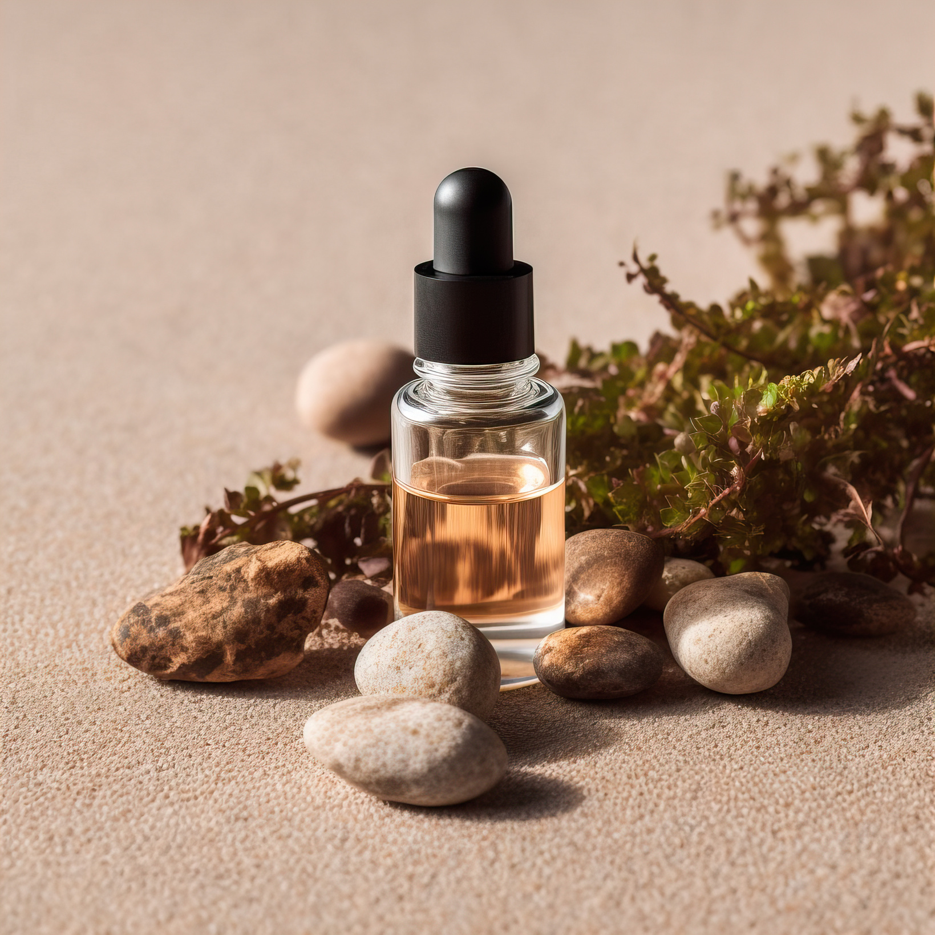
THANK YOU!

Slide 11
REFERENCES
Kiper, D. (2022, October 14). Understanding Labor Hours and Labor Costs. Ecmweb.com; EC&M. https://www.ecmweb.com/construction/estimating/article/21251577/understanding-labor-hours-and-labor-costs
Veryable | Step into the Future of Manufacturing & Logistics. (2021). Veryableops.com. https://www.veryableops.com/blog/labor-optimization-availability-vs-productivity
Cosmetics Market Size, Share & Trends Analysis Report by product (Skin care, hair care), by end-user (Men, Women), by distribution channel (Offline, online), by region (North America, Europe), and segment Forecasts, 2024 - 2030. (n.d.). https://www.grandviewresearch.com/industry-analysis/cosmetics-market
Technavio. (n.d.). Cosmetic Products Market Analysis APAC, North America, Europe, South America, Middle East and Africa - US, China, South Korea, India, Japan, Australia, Germany, Canada, UK, Brazil - size and forecast 2025-2029. Technavio, https://www.technavio.com/, All Right Reserved 2025. https://www.technavio.com/report/cosmetics-market-industry-analysis
Smirnov Patrashkov, I., & Suresh, P. (2020). Risk management in global supply chains - A review based on the impact of COVID-19. In Master’s Thesis. https://www.diva-portal.org/smash/get/diva2:1548538/FULLTEXT01.pdf
Praharjo, A., & Wijaya, R. (2023). Consumer’s behavior intention in using green skincare products. In Routledge eBooks (pp. 176–183). https://doi.org/10.1201/9781003360483-20
‌
‌

Slide 12
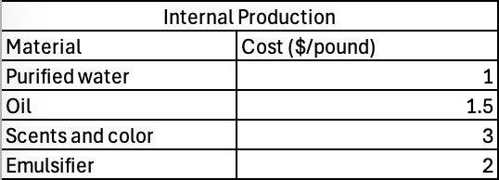
APPENDIX
1- Demand (number of cartons)
2- Labor Costs ($/h)
3- Internal Production Cost ($/pound)
PAGE 11

Slide 13
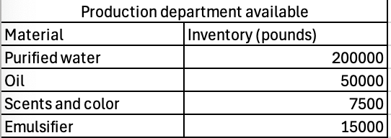
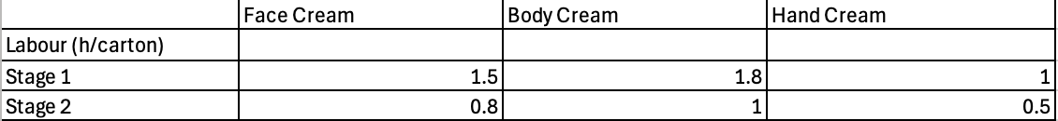
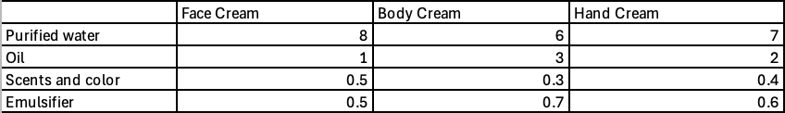
4- Production department inventory availability (pounds)
5- Labour hours per stage per carton of product (h/carton)
6- Materials per carton of product (pounds/carton)

Slide 14
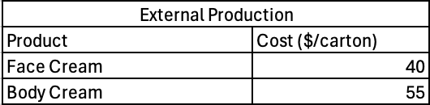
7- External Production Cost ($/carton)
8- Cost per carton ($) for each production

